Slide 1
Java + Javafx
Model of the Solar System

Slide 2
The first step *VERY IMPORTANT* is design!

Slide 3
Java is an object oriented language.
Objects have variables and functions that act on those variables.
Classes provide a cookie cutter for creating many of the same type of object.

Slide 4
Inheritance
An object can “inherit” from another object to add or redefine new variables and methods
Example: dog inherits from animal class

Slide 5
CelestialBody
Star
Planet

Slide 6
CelestialBody
A sphere which follows the mouse when created, which is set down when clicked.

Slide 7

Import statements
Java doesn’t always have all the tools you need, so add more using imports.

Slide 8
Creating a class
Encapsulation: public, private, protected
1 public class per file whose name matches the file name
Brackets matter, not indentation

Slide 9
Variables
Object type followed by name
A Sphere named sphere will be made for every CelestialBody object

Slide 10
Constructor
A constructor is a special function called each time you create a new object, which assigns values to variables and gives any of the initial info needed, then returns the newly created object. You do not specify return type.
Named after the class name.
The variables which go into the function
f(x)

Slide 11
Assign values to class variables
Sphere is a class from javafx which takes a number value representing the radius.

Slide 12
Add sphere to pane.
This will make it show on screen.
Javafx uses “panes” to store shapes. We will make these later.

Slide 13
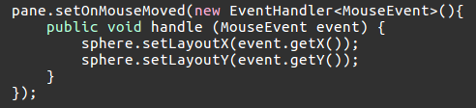
Event Handlers
Event - when the mouse is moved or clicked
Events are “handled” by specifying what to do when they happen
LayoutX is the x position on screen.
Set to where the mouse moved.

Slide 14
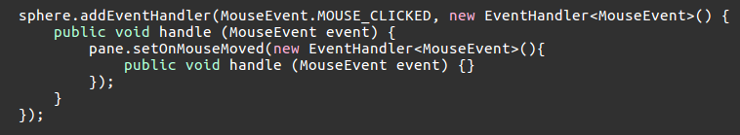
Set down sphere when clicked
Handler is added to the sphere
Click is handled by changing the handler we made for mouse move.
Mouse moved handler is now empty (no longer moves sphere).

Slide 15
CelestialBody is done! Close your parenthesis!

Slide 16
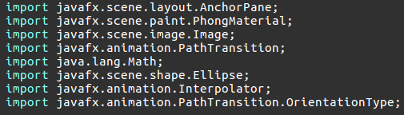
Children of CelestialBody - Planet
New file, new imports

Slide 17
Planet class extends CelestialBody
It automatically has the functions and variables of its parent.

Slide 18
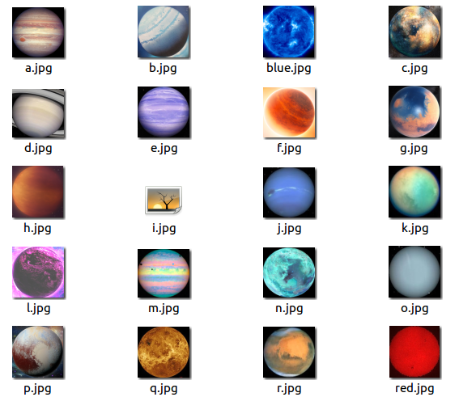
Planets are sooo extra!
Spheres have planet colors and orbit stars.

Slide 19
Planet class variables - What does each Planet need?
PathTransition is a javafx class which defines a path to move shapes along for a certain amount of time and certain amount of cycles. Our PathTransition is called pathTransition.

Slide 20
Planet Constructor
First must call the function super(), which creates an object from the parent class - in this case, a CelestialBody.

Slide 21

Add an image to the sphere
Create a material, add an image to the material, add the material to the sphere.
We will write the function pickPlanetColor() ourselves, which decides which image this planet gets based on how big it is.

Slide 22

Set up the PathTransition
SetNode() applies the PathTransition to this sphere.
setCycleCount(-1) makes the animation run forever
We change the orientation so the planet turns while it orbits
The animation by default will accelerate at the beginning and decelerate at the end, so we change this so there is no change from cycle to cycle.

Slide 23
Constructor is finished! Close it up!

Slide 24
Writing the function pickPlanetColor()
Returns an Image object
f(x) = y
“double” is a number, one of java’s primitive values (next slide)
Function is private because it’s
only used by the Planet class.

Slide 25
Java Primitives
Values stored directly in memory
Char - a letter
Boolean - true or false
Byte - 8 bit integer
Short - 16 bit integer
Int - 32 bit integer
Long - 64 bit integer
Float - 32 bit rational
Double - 64 bit rational

Slide 26
If statement *important*
Used to decide which action should be performed based on conditions
if (a is true) {
Do this
} else if (b is true) {
Do something else
} else {
Do something else
}

Slide 27
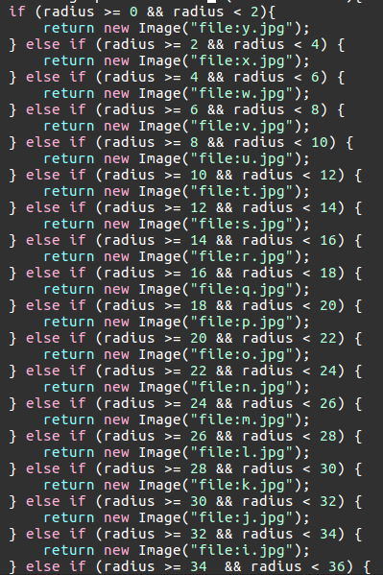
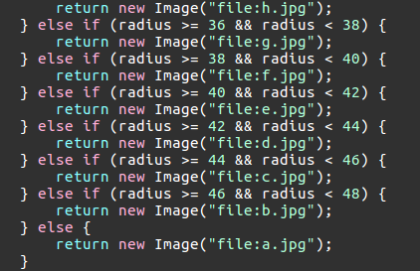
Decide which image for which planet.
25 planet images divided up over radii of 0 to 50

Slide 28
That’s all for the Planet class!

Slide 29
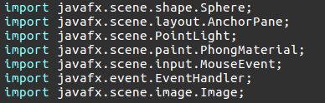
Star class
Stars are light sources and have different images.
Imports:

Slide 30

Star class variables
Javafx object PointLight illuminates from a point

Slide 31

Star Constructor
Create a CelestialBody.
We will write pickSunColor().
The material of the Star sphere must be self lit since the light source is coming from the same point.

Slide 32

Let There be Light!
Create a new PointLight object.
Sink the light down (just because it looks funky).
Add it to the pane so it is drawn on screen.

Slide 33
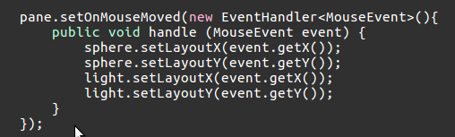
Light source should also follow mouse movement.

Slide 34
That’s all for Star constructor!

Slide 35
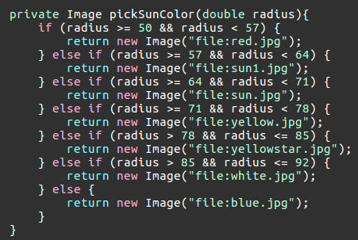
pickSunColor() same as pickPlanetColor()
6 images for radii 50 - 100

Slide 36
Star class is finished! Hooray!

Slide 37
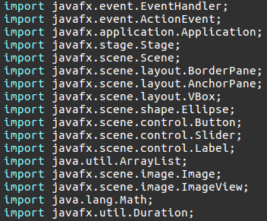
Time to tie it all together with our SolarSystem class
This is the main program which will use our other class.
Imports:

Slide 38
Graphical User Interface
First, we will make our SolarSystem class a child of javafx’s Application class. This will give it the ability to make a window and everything the average joe thinks of as a computer program without writing it ourselves.

Slide 39
main()
When you tell java to run a program, the first place it will start is with whichever function you name “main.” This function will be declared just like this for any java program you write:
“Static” means this function acts on its own without needing an object to act on. We will not be making any SolarSystem objects.
“Void” is the return type used when you aren’t going to return anything at all.
String[] args is an array named args, of strings which are variables that come from the command line when you run the program.

Slide 40
Arrays *important*
We won’t use them in our program (no args needed), but they are very useful and used in a lot of languages.
A storage box that can hold objects or primitives.
Must declared what you are filling it with and how big it is beforehand, but can change the contents at any time.
String[] thisIsAnArray = {“cat”, “dog”, “frog”};
Star[] anotherArray = new String[5];
thisIsAnArray[1] = “duck”;

Slide 41
Back on track...
The only thing we will do in main is call the function launch, which is a part of Application. Launch will in turn call another function called “start” which we will write to say everything we want in our window when it is created.

Slide 42
Javafx layout
Stage
Scene
BorderPane
VBox
AnchorPane

Slide 43
Start
When start() is called by launch(), we are given a Stage object to build on.

Slide 44
Window Title
Calling the function setTitle(“”) on our stage will change the name of our solar system window.

Slide 45
Javafx layout
Stage
Scene
BorderPane
VBox
AnchorPane

Slide 46

Make panes.
Make the right side of the BorderPane be the AnchorPane.
Set the Scene of the Stage to be size 1000x1000 with BorderPane in it.

Slide 47

Majestic space background
When we want an Image to stand on its own (not as a sphere material) we make an ImageView. Then add it to the AnchorPane to make the background.

Slide 48

We will write a new function called addButtons() which makes buttons and sets their actions when clicked (more event handlers!)
The last step is to call show() on the stage to show everything on screen.

Slide 49
start() is now written!

Slide 50
Let’s make buttons!
Do you remember all the parts of a function declaration?

Slide 51

Create - make a new CelestialBody
Clear - delete the CelestialBody just made
Start - planets will orbit
Stop - planets stop orbiting

Slide 52

VBox
Stack the buttons vertically in a vertical box.
Make the button box the left side of the BorderPane.

Slide 53

Make it pretty
Button width by default matches the word length.

Slide 54

Choosing radius
Slider values start at 0, end at 100, and increment by 1

Slide 55
ArrayList<>
An ArrayList is an array which can change length (but not object type).
We will make one to hold our CelestialBodies.

Slide 56
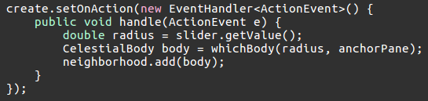
Button Event Handlers
Get the radius from the slider.
We will write whichBody(), a function which returns a Star or Planet.
Add the CelestialBody to the ArrayList which holds them all.

Slide 57
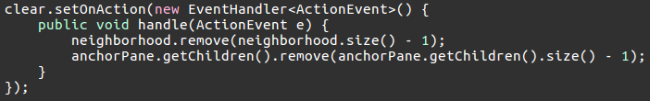
Clear
Remove the last CelestialBody from the space neighborhood.
Arrays, ArrayLists, etc. are indexed starting from zero, so the size will be one too big
0 1 2
Array size 3

Slide 58
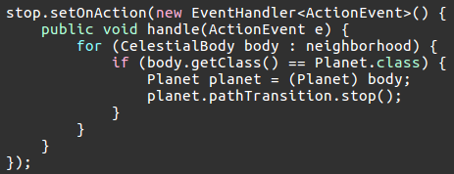
Stop
Stars do not orbit, but they are included in our neighborhood. So we will check that our CelestialBody is a Planet before we try to change its movement.

Slide 59
For loops *important*
Perform an action on every object in a group.
This loop will continue to do the same thing for every CelestialBody in neighborhood until there are none left.

Slide 60

Polymorphism
We can treat a CelestialBody as if it were one of its children, but only if we tell java that we know for sure by “casting” the CelestialBody as a Planet. (Casting is also used for numbers if you want to switch between decimals and integers)
Get the PathTransition of the Planet and stop it.
A = B set A to be the value B
A == B are A and B the same?

Slide 61

Start
Begin with the same thing we did for stop - pick out the Planets from neighborhood.

Slide 62
Set the path of the PathTransition
The path is just a shape object. Before we made a sphere, now we will make an ellipse.
(0,0)
(140,0)
(430,430)
Our elliptical path is centered on the middle
of our starry AnchorPane
radius
(1000,1000)

Slide 63

Using intermediate values helps break up lines
Center x, center y, semi-major axis, semi-minor axis

Slide 64


Kepler’s 3rd Law

Slide 65
Close if statement! Close for loop! Close event handler! Close addButtons()!

Slide 66
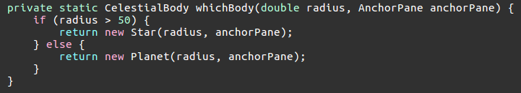
Star or Planet?

Slide 67
Congratulations, you are now a Java programmer!!

Slide 68
Java is a compiled language.
Since computers don’t speak English, we need to translate first.
Compiling our .java files creates .class files which can be run by the computer.

Slide 69


